Slide 1
Enterprise Asset Management (EAM)
Curriculum: Introduction to S/4HANA using Global Bike

Slide 2

4.3 (July 2025)
SAP S/4HANA 2023
Fiori 3.0
Global Bike
No Prerequisites needed

Slide 3
Stefan Weidner
Robert Häusler
Chris Bernhardt
Babett Ruß
Beginner

Slide 4
You are able to
name some functionalities of the EAM module.
define the central organizational structures of the EAM module.
summarize the master data which is most important for the EAM module.
explain a standard process of the Enterprise Asset Management.

Slide 5
Functionality
Planned Repair
Instant Repair
External Assignment
Refurbishment
Preventive Plant Maintenance
Project oriented Plant Maintenance
Shift Reports and Shift Notes

Slide 6
Agenda
EAM Organizational Structure
EAM Master Data
EAM Processes

Slide 7
GBI Structure for Enterprise Asset Management
Global Bike
Client
Global Bike Inc.
Global Bike Germany GmbH
Company
Code
Dallas
San Diego
Miami
Heidelberg
Hamburg
Plant
Maintenance
Plant
Responsible
Maintenance
Planning Plant
Misc
Storage
Location

Slide 8
EAM Organizational Structure
Client
  An independent environment in the system
Company Code
  Smallest org unit for which you can maintain a legal set of books
Plant
  Operating area or branch within a company
    Manufacturing, distribution, purchasing or maintenance facility
Storage Location
  An organizational unit allowing differentiation between the various stocks of material in a plant
  Is required to store spare parts

Slide 9
EAM Organizational Structure
Maintenance Plant
  Plant in which the technical objects of a company are installed
Maintenance Plant oriented organizational units:
  Location (e.g. building number, coordinates)
  Plant Section (responsibility for working assets)
  Work Center (process measures of plant maintenance)
Maintenance Planning Plant
  Plant in which maintenance tasks are planned and prepared
Planning Plant oriented organizational units :
  Maintenance Planner Group (responsible for planning and processing maintenance tasks)
  Work Center

Slide 10
GBI Enterprise Structure in SAP ERP (EAM)
TG00
TG00
Storage
Location
FG00
FG00
MI00
MI00
MI00
MI00
MI00
MI00
MI00
Central Purchasing Organization (global) GL00
CA00
Purchasing Org. US00
CA00
PO DE00
AU00
Purchasing Group North America
N00
PGr Europe
E00
Asia
A00
Dallas
DL00
Miami
MI00
S. Diego
SD00
Toronto
TO00
Heidelb.
HD00
Hamburg
HH00
Perth
PE00
Plant
CC US00
CA00
CC DE00
AU00
Company Code
Client GBI
Notes:
Grau dargestellte Organisationseinheiten existieren noch nicht in GBI, sind aber bereits geplant.

Slide 11
Agenda
EAM Organizational Structure
EAM Master Data
EAM Processes

Slide 12
EAM Master Data
Functional Location – Master Data
Equipment – Master Data
Bill of Material
Functional
Location
Equipment
Bill of Material

Slide 13
Functional Location – Definition
Hierarchically organized structure which represents e.g. a technical system, a building or a part of it
Locations are normally fixed and do not move
Structures maintenance objects according to following criteria:
  spatial (e.g. buildings)
  technical (e.g. pumping plant)
  functional (e.g. production of bicycle frames)
Functional locations can be used to sub-divide the objects into similar maintenance units
Functional locations can contain different types of equipment

Slide 14
Functional Location – Advantages
Structural depiction of a technical plant
  Structure indicator makes hierarchy levels visible
Planning and performing maintenance tasks
Verification of maintenance tasks
Data gathering for extended periods of time
Cost monitoring
Behavioral analysis individual areas under different conditions

Slide 15
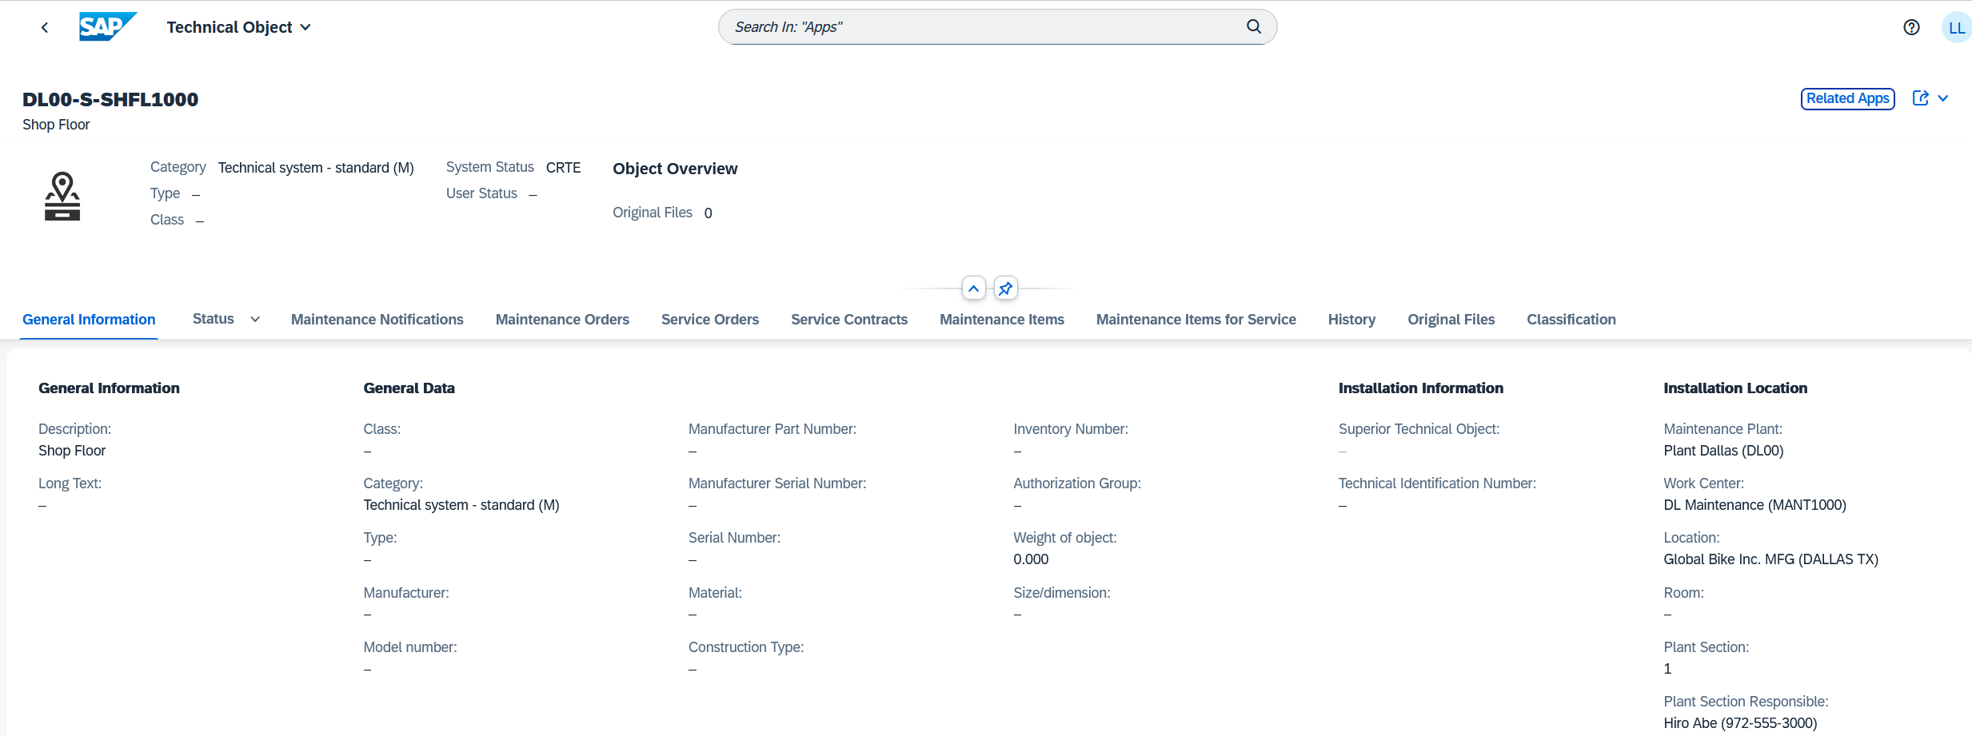
Functional Location – Master Record
Functional Location Master Data
  contains all information about the functional location
  Could be required in order to perform maintenance activities

Slide 16
Equipment – Definition
Individual and autonomous technical unit
Physical object for which maintenance tasks are planned and performed
Mobile character
Examples: pumps, personal computers, circulation fan, engines
Equipments can be placed in functional locations

Slide 17
Equipment – Advantages
Administration of individual objects and data
Verification of maintenance tasks
Object oriented cost monitoring
Data gathering and analysis for extended periods of time

Slide 18
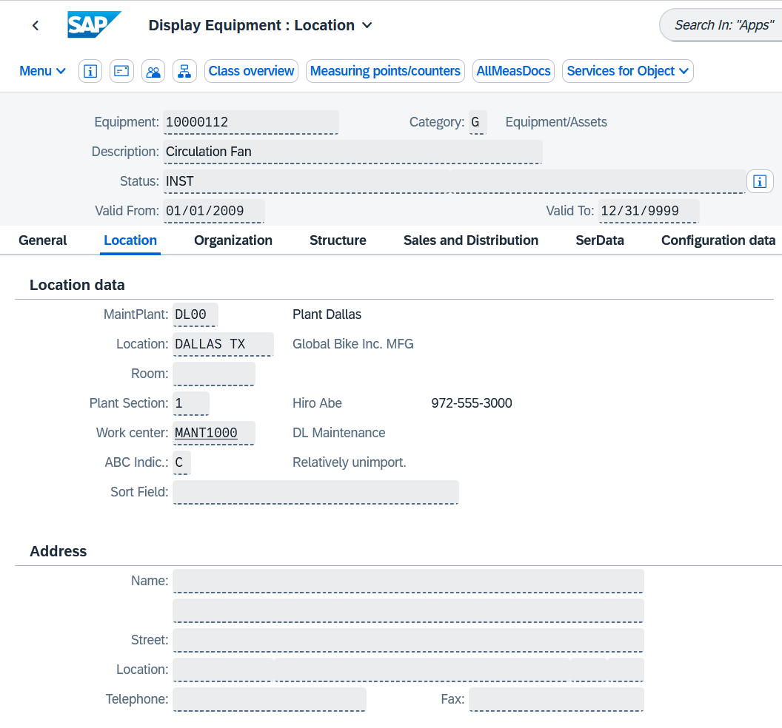
Equipment – Master Record
Equipment Master Data
  contains all information around
  equipment
Information in four views:
  General
  Location
  Organization
  Structure

Slide 19
Bill of Material – Definition
Complete formally structured list of all components
Material BOMs can be allocated to functional locations or equipment
Three types of BOMs in Enterprise Asset Management:
  Material BOMs
  Equipment BOMs
  Functional location BOMs

Slide 20
Bill of Material – Advantages
Structuring of objects
Service parts planning in maintenance orders and maintenance task lists
Within plant maintenance BOMs are used if there are similar objects that can be maintained

Slide 21
Agenda
EAM Organizational Structure
EAM Master Data
EAM Processes

Slide 22
EAM Process (Planned Repair)
1. Notification
2. Planning
3. Controlling
4. Implementation
5. Completion

Slide 23
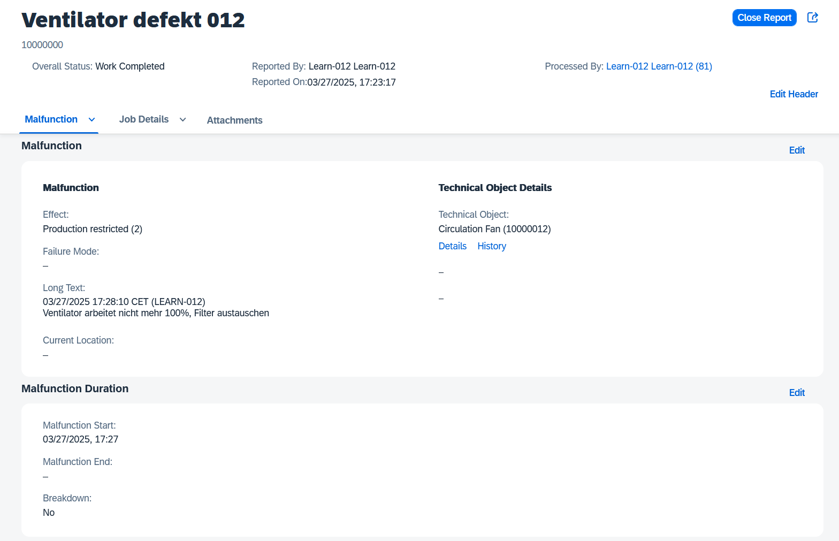
Notification
Malfunctions and other
requirements are gathered in
notifications
Content:
  Technical object
  Reported by
  Effect
  Description
  Date
  Breakdown

Slide 24
Notification
Notifications are used to tell maintenance that something needs fixing
They may or may not contain technical information
They will often highlight a breakdown that needs to be actioned quickly
Requirement of necessary maintenance measures
Notifications can also be used to record works already carried out because a history needs to be maintained

Slide 25
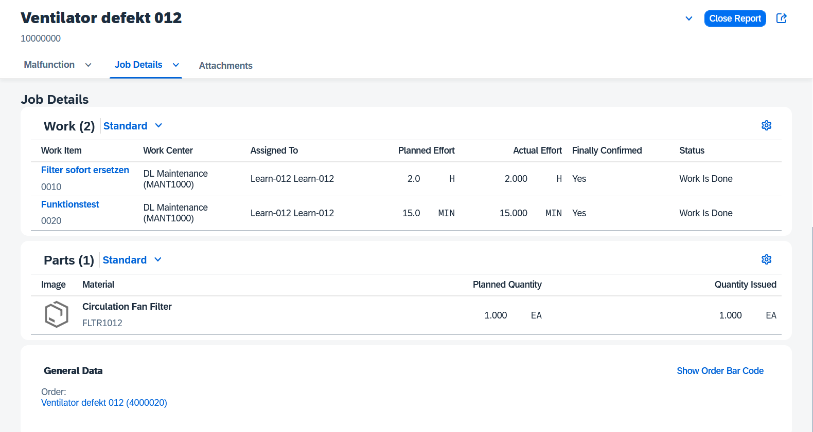
Planning
Order creation and order
planning is normally triggered from a notification
Order planning can include:
  The steps to be Performed (Work)
  Required spare parts (Part)

Slide 26
Planning
Maintenance orders can be created from maintenance plans, notifications or created without any reference document
Responsibilities for external or internal work are defined
Material reservations take place order upon release
Production resources like protective clothing and specialist tooling can be listed
Planned costs are calculated based on internal activity rates and external service costs

Slide 27
Maintenance Order Control Functions
Control functions for maintenance orders can vary depending on the type of order
Order release is carried out once planning has been completed
Maintenance orders provide the following functions:
  Mass change or mass editing
  Availability check for spare parts
  Capacity requirements planning
  Printing work instruction papers

Slide 28
Execution and Completion
Order Execution
Planned and unplanned material withdrawals (goods issue) are possible
Order Completion Steps:
  Time confirmation
  Technical completion confirmation
  Technical completion
Customer billing can be performed after successful technical completion

